Slide 1



Master Thesis in Physics of Data
Biological Networks as Defense against
Adversarial Attacks
Supervisor
Prof. Marco Baiesi
Master Candidate
Andrea Zanola

Slide 2

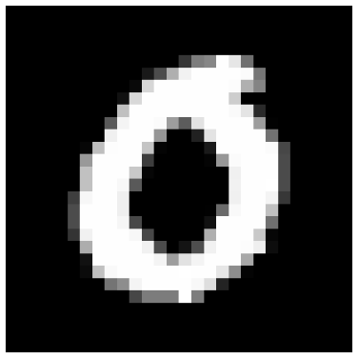
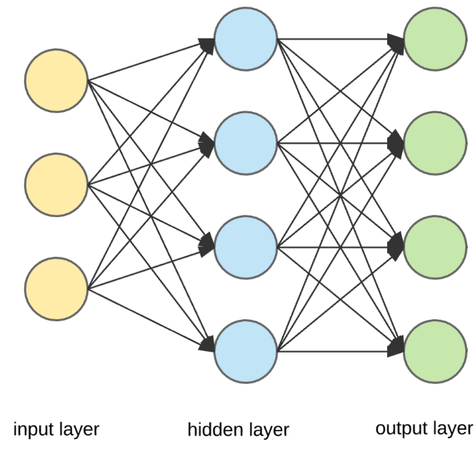
Introduction
Does artificial neural networks really work?
The first exercise that a student does studying ML, is MNIST digit classification.
Dataset:
MNIST, 70000 b/w images of handwritten digits, 28x28 pixels.
Base solution:
- ANN with min 3 layers, 784 neurons in input and 10 in output;
- Activation Functions: Linear-ReLU-Softmax.
- Loss Function: Cross-Entropy.
- Training Procedure: Back-propagation in PyTorch.
Results:
- Test Accuracy: 96%!
- CPU time: 1-2min
Is there something else, or this is all what we need?

Slide 3
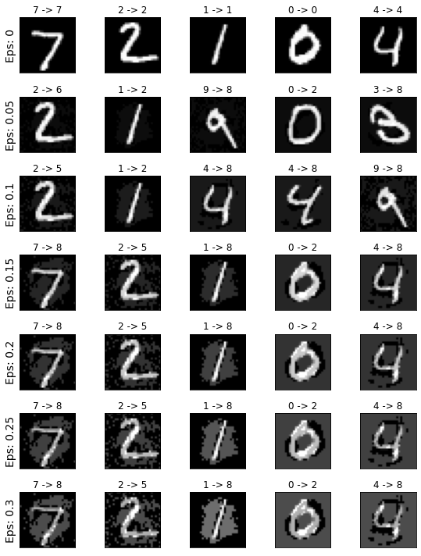
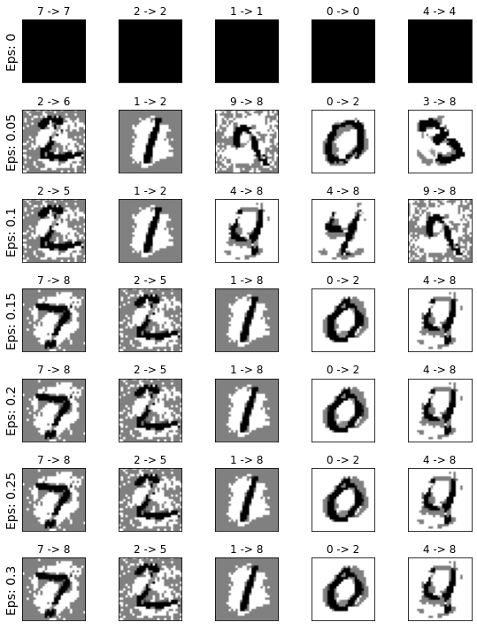
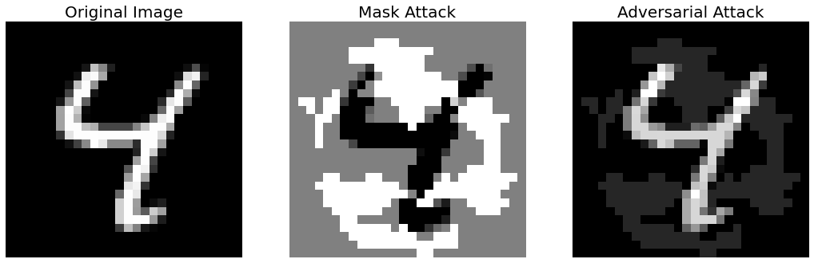
Adversarial Attacks
Adversarial Attacks
Suppose to give in input to the network the following images:
These are not MNIST images!
The predicted labels are:
6 2 8 2 8
Several ways to create the mask attack:
the most famous is FGSM (Fast Gradient Sign Method) and it was used to generate the examples above.
+
=
Fig. Example of an adversarial attack.
Szegedy et al. described such weakness of ANN in: “Intriguing properties of neural networks”, 2014.

Slide 4
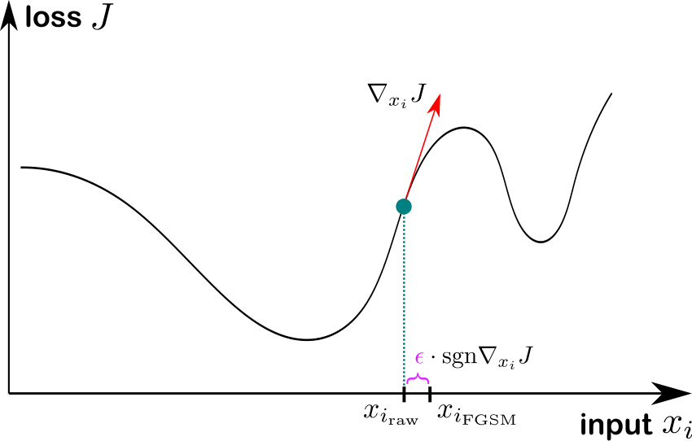
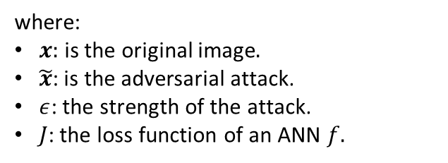
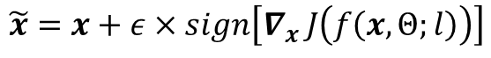
FGSM Algorithm
The FGSM algorithm calculates the direction that appears to be the fastest route to a misclassification.
The formula defining the FGSM attack is:
FGSM Adversarial Attack
$$\tilde{x}=x+ε×sign\left[∇_{x }J\left(f\left(x,Θ;l\right)\right)\right]$$
Mask Attack
where:
$x:$ is the original image$.$
$\tilde{x}$: is the adversarial attack.
$ε$: the strength of the attack.
$J$: the loss function of an ANN $f.$
Fig. FGSM algorithm. Image taken from «Improving robustness of jet taggin algorithms with adversarial training», by A. Stein et al. (2022).

Slide 5
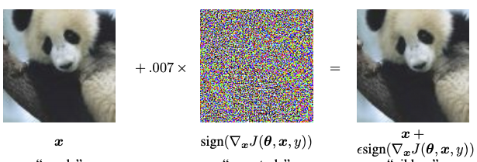
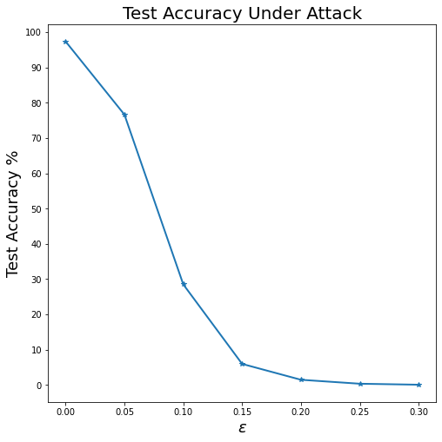
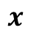

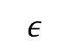
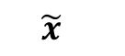
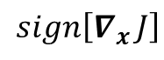
Accuracy Under Attack
One of the most famous examples is that of a panda classified as a gibbon!
$$ε$$
$$+ε×sign\left[∇_{x }J\left(f\left(x,Θ;l\right)\right)\right]$$
$$x$$
$$sign\left[∇_{x }J\right]$$
$$\tilde{x}$$
PANDA 57%
GIBBON 99.7%
A simple ANN, trained in PyTorch is not adversarial robust.
Let’s call test-accuracy under attack the accuracy that
an ANN has giving in input as test set images, samples that are adversarial attacks.
Fig. Goodfellow’s famous example. Image taken from «Explaining and harnessing adversarial examples», by I. Goodfellow et al. (2015).
Fig. Test accuracy under attack for an ANN trained only with BP.

Slide 6
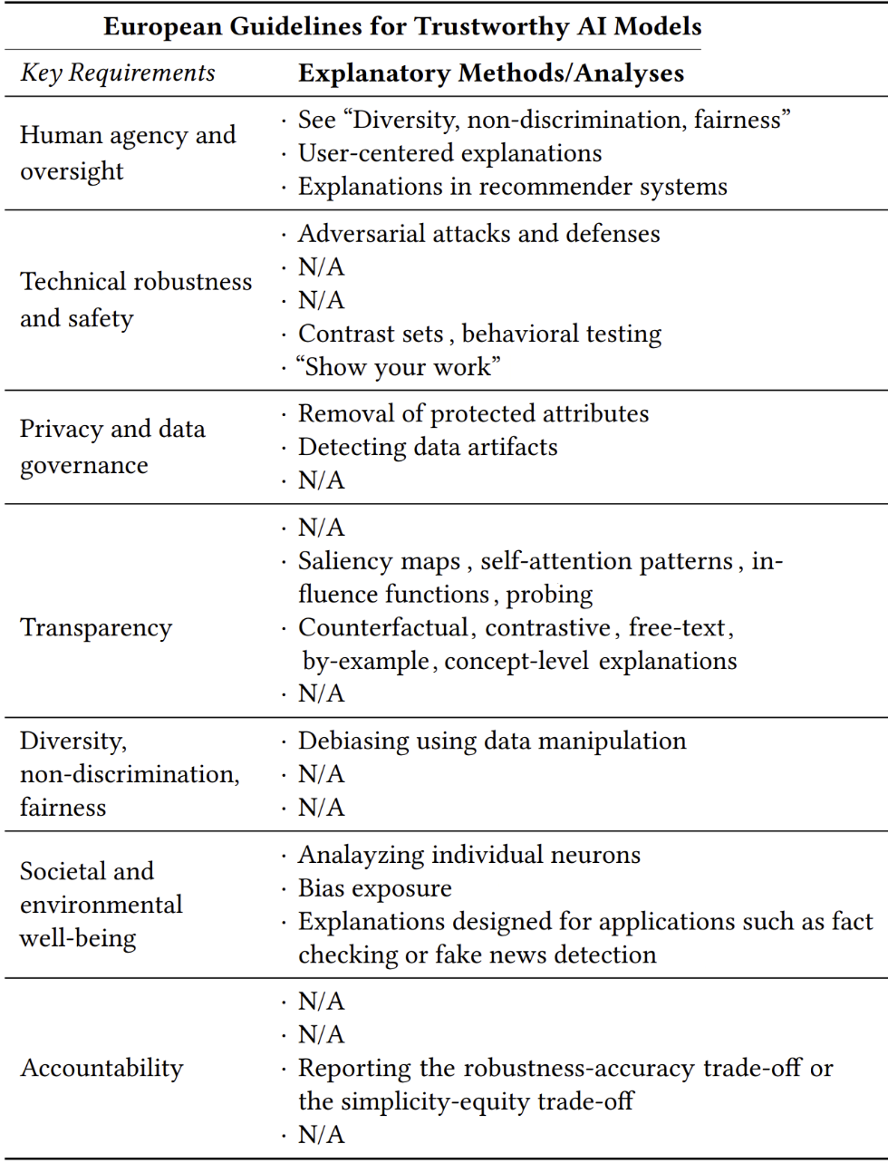
EU Guidelines
The adversarial vulnerability is a disaster, since the current ML research is every day more and more focused in finding architectures that not only have a great test-accuracy, but that also have other qualities, like technical robustness and transparency.
Performance or Interpretability?
Robustness: it is the ability to resist against adversarial attacks.
Transparency: a model might be called transparent if a person can contemplate the entire model at once.
Many key-requirements help to build broader trust on AI:
Trustiness: the ability to anticipate the AI behavior.

Slide 7
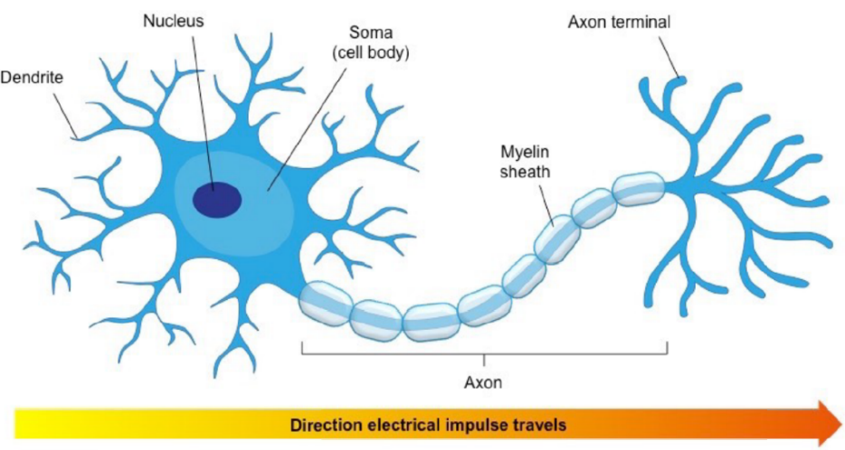
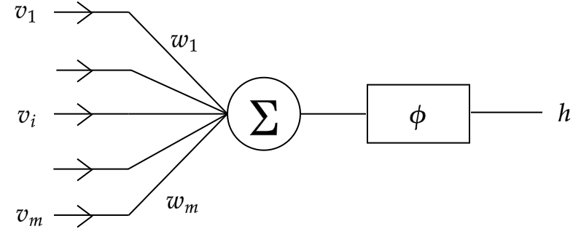
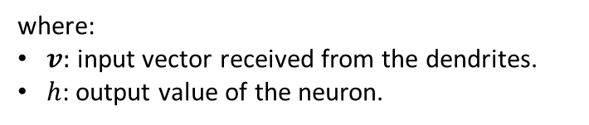
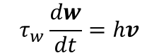
Biological Networks
A neuron essentially is composed by:
Ramifications, called dendrites that receive signals in input.
A soma, which contains a nucleus.
An axon that transmits the signal towards other neurons.
The real brain is plastic, a human can ”rewire” it with habits and new experiences.
The simplest form of plasticity is that neural pathways that are used a lot strengthen.
This inspired the Hebb’s principle.
Fig. Biological neuron.
$$τ_{w}\frac{dw}{dt}=hv$$
where:
$v:$ input vector received from the dendrites.
$h$: output value of the neuron.
Fig. McCulloch-Pitts’ model of a neuron.
However, two missing ingredients: competition and synapses weakening.

Slide 8


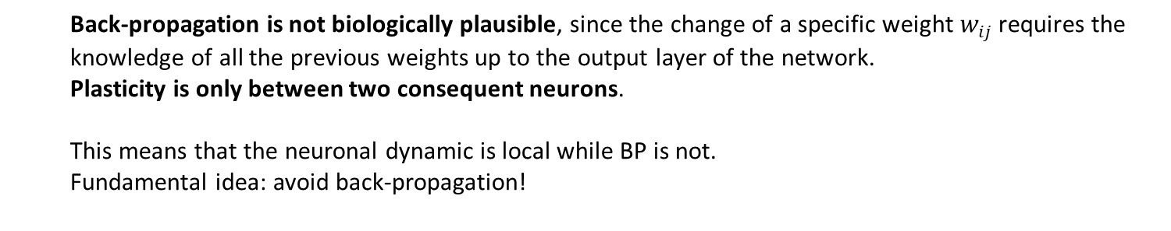
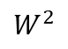
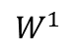
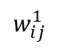
Artificial Networks
“It is widely believed that end-to-end training with the back-propagation algorithm is essential [...].
At the same time, the traditional form of back-propagation is biologically implausible” D.Krotov - J.J. Hopfield
Back-propagation is not biologically plausible, since the change of a specific weight $w_{ij}$ requires the
knowledge of all the previous weights up to the output layer of the network.
Plasticity is only between two consequent neurons.
This means that the neuronal dynamic is local while BP is not.
Fundamental idea: avoid back-propagation!
a)
b)
$$w_{ij}^{1}$$
$$W^{2}$$
$$W^{1}$$
First layer is trained in the first phase,
while the second in the second phase.

Slide 9
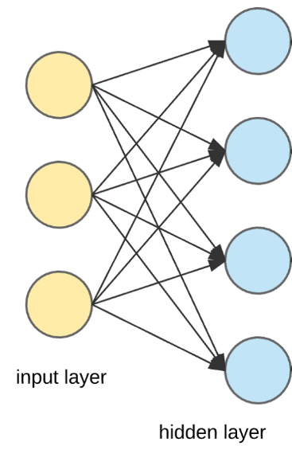
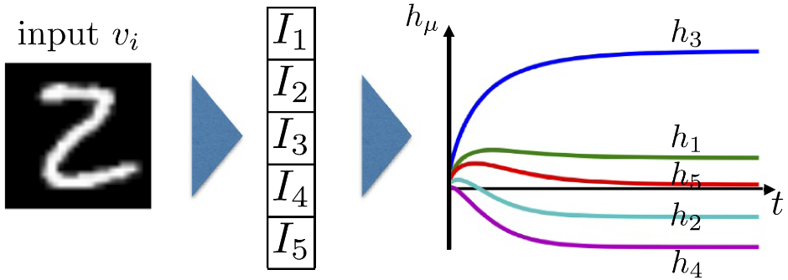

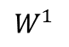
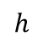
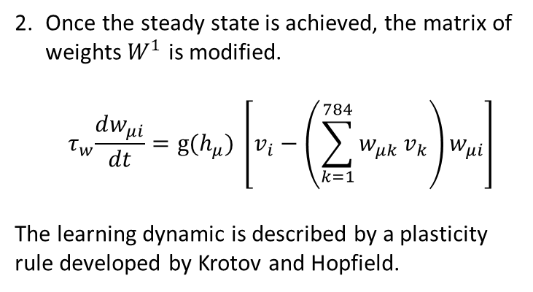
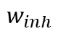
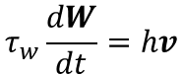
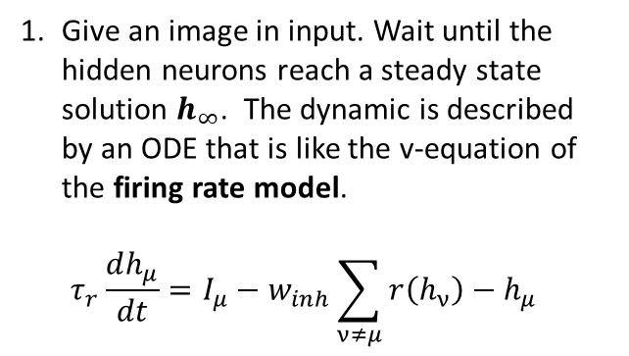
First Layer
The first layer is trained in a biological way and the training is constituted by the iteration of two steps,
for each training example:
First Layer
Give an image in input. Wait until the hidden neurons reach a steady state solution $h_{∞}$. The dynamic is described by an ODE that is like the v-equation of the firing rate model.
$$τ_{r}\frac{dh_{μ}}{dt}=I_{μ}−w_{inh}\sum_{ν≠μ}{r\left(h_{ν}\right)}−h_{μ}$$
Once the steady state is achieved, the matrix of weights $W^{1}$ is modified.
$${ τ}_{w}\frac{dw_{μi}}{dt}=g(h_{μ}) \left[v_{i}−\left(\sum_{k=1}^{784}{w_{μk}}v_{k}\right)w_{μi}\right]$$
The learning dynamic is described by a plasticity rule developed by Krotov and Hopfield.
$$h$$
$$W^{1}$$
1
$$τ_{w}\frac{dW}{dt}=hv$$
$$w_{inh}$$
2

Slide 10
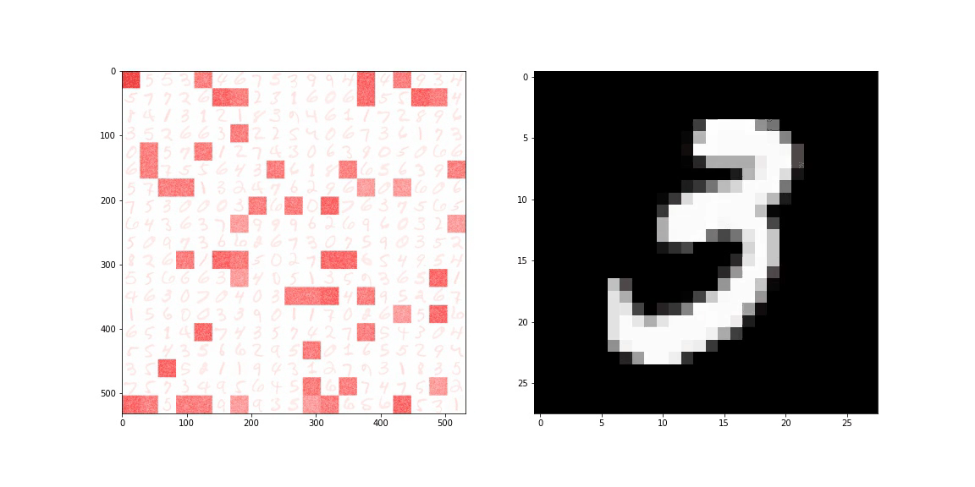
Visualization 1° Phase
Visualization of the First Phase

Slide 11

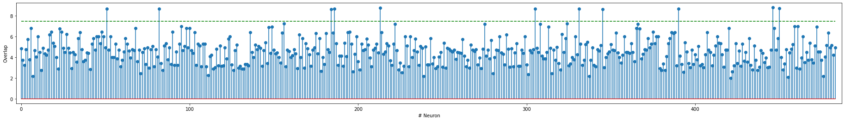
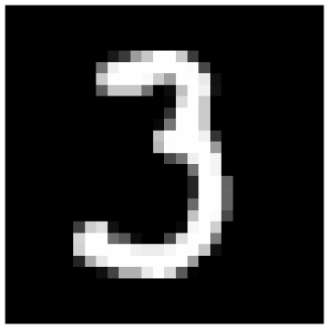
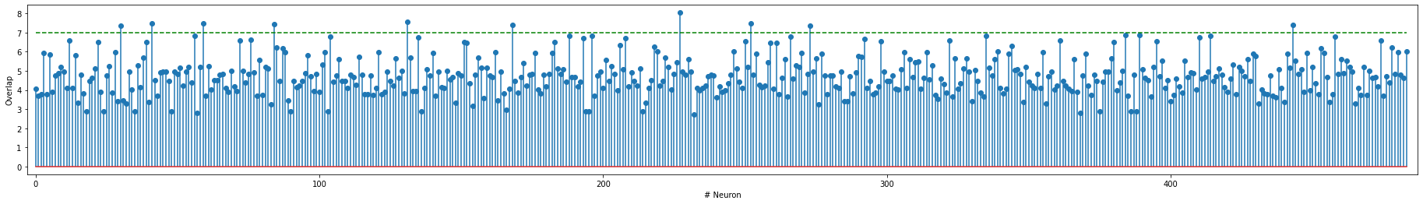
Super-active Neurons
A network trained with the algorithm proposed by Krotov and Hopfield is not adversarial robust!
The second layer is trained with a new algorithm proposed by me.
Turns out that exists «super-active» hidden neurons to some type of digits. They are defined as the top 5% neurons with the higher activation value.
Top active
hidden neurons
Fig. Two examples of activation profile in the hidden layer.

Slide 12
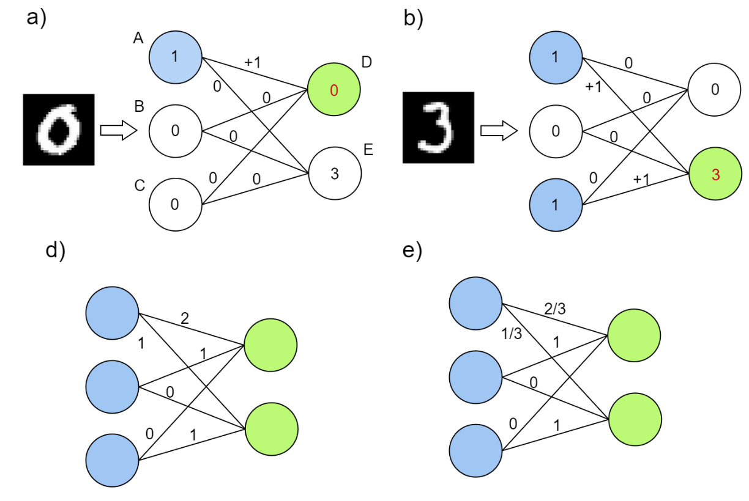
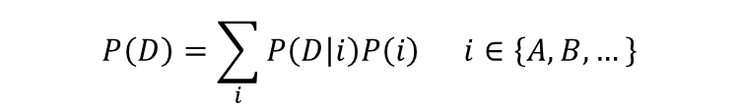

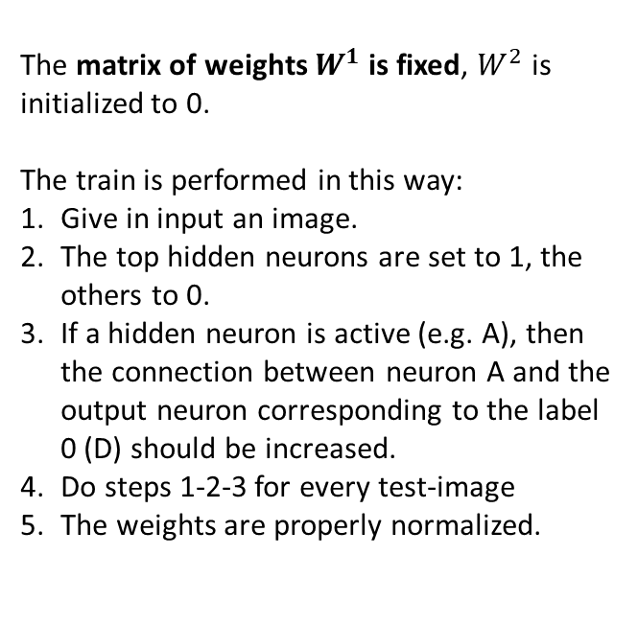
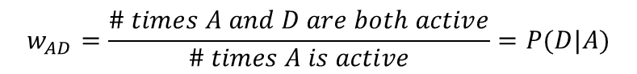
Second Layer
The matrix of weights $W^{1}$ is fixed, $W^{2}$ is initialized to 0.
The train is performed in this way:
Give in input an image.
The top hidden neurons are set to 1, the others to 0.
If a hidden neuron is active (e.g. A), then the connection between neuron A and the output neuron corresponding to the label 0 (D) should be increased.
Do steps 1-2-3 for every test-image
The weights are properly normalized.
Second Layer
$$w_{AD}=\frac{\# times A and D are both active}{\# times A is active}=P(D|A)$$
Fig. Illustrated training procedure.
$$P(A)=\frac{\# times A is active}{\# images presented in input}$$
$$P\left(D\right)=\sum_{i}{P\left(D | i\right)P\left(i\right) i∈\left\{A,B,…\right\}}$$

Slide 13
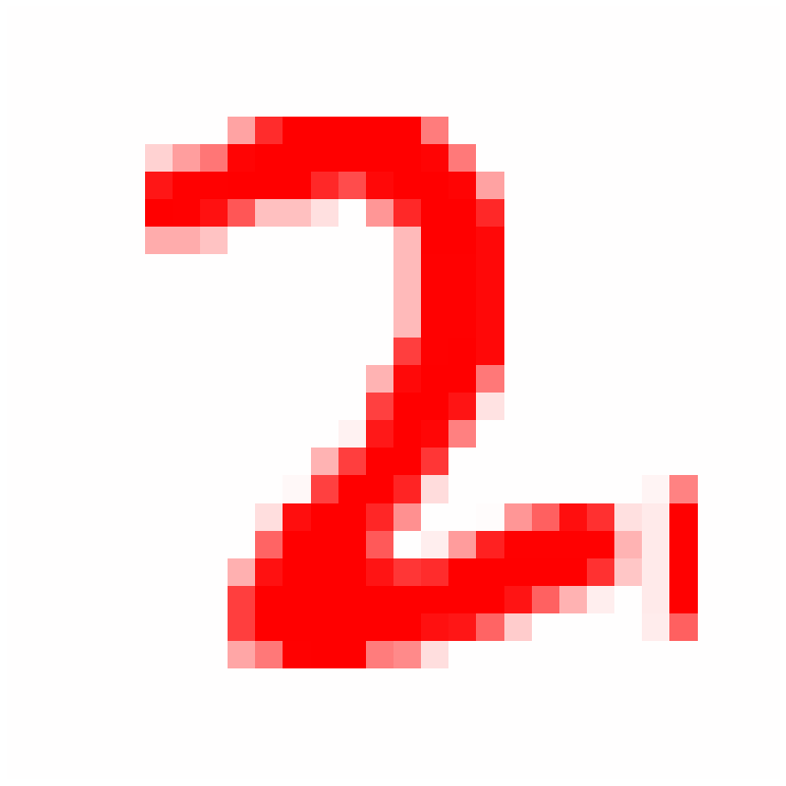
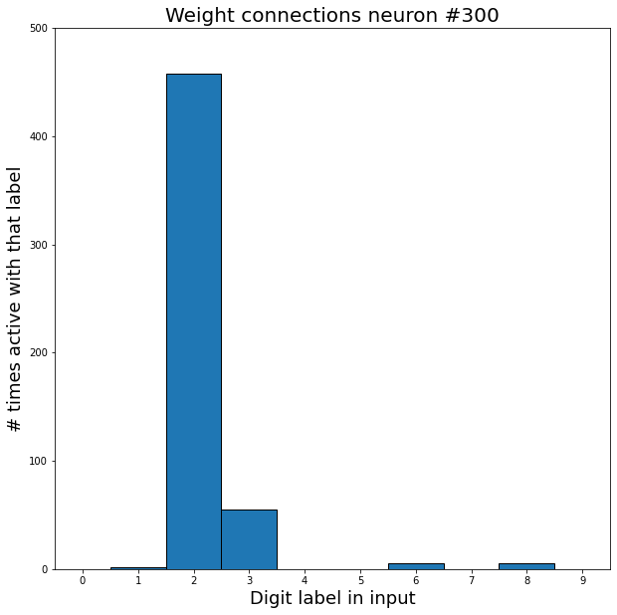
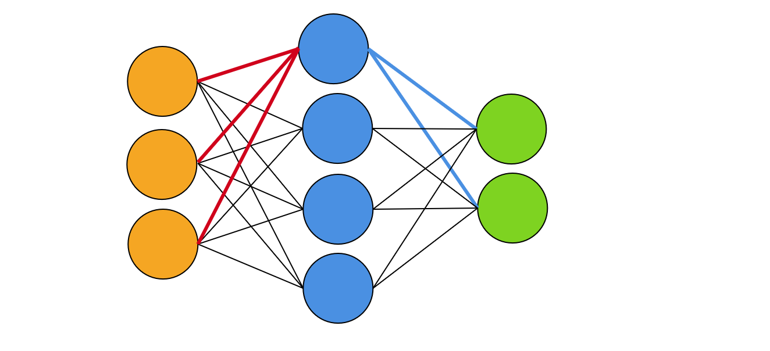
Visualize $W^{2}$
#300
Fig. Visualization of counts for neuron n°300.

Slide 14
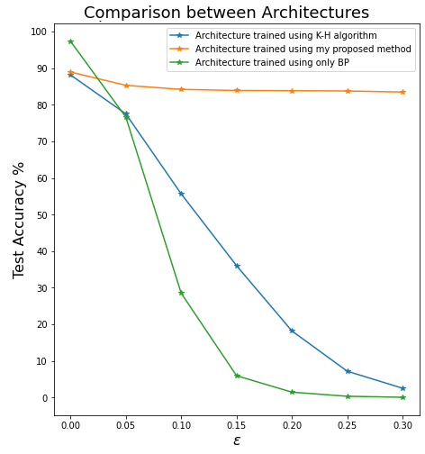
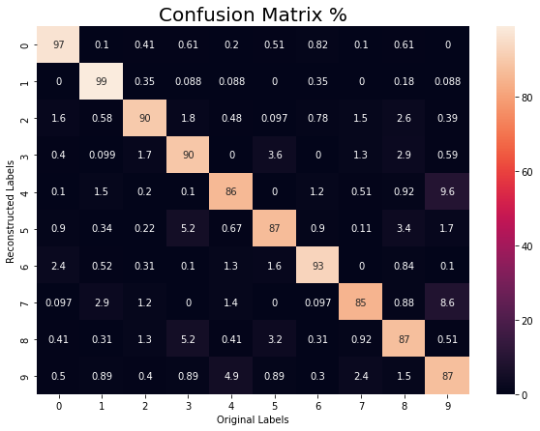
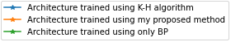
Results
Main drawbacks:
Not an excellent test accuracy, 90.16% (97% with BP).
Slow training procedure 10min (2min with BP).
Results
Main advantages:
Network is transparent.
Adversarial robustness is greatly improved.
Network robust respect many types of attacks like BIM, PGD, FFGSM and others.
Fig. Comparison between training procedures.

Slide 15
Conclusions
Nowadays, machine learning would be applied in every sector of the market:
finance, health-care, cooking instruments, smartphone, cyber-security and many others.
Lot of companies and investors are investing money in developing ML algorithm.
The problem is that ML gives right answers only to right questions.
Assume a ML algorithm capable to give almost always the right answers to your problem:
if you don’t have trust in it, all the ML framework is pointless.
The final philosophical take-home message is: frame your problem from the human point of view.
Indeed, the decisions suggested by a decisional model are made for humans!
Conclusions

Slide 16
Thank you for your attention!

Slide 17
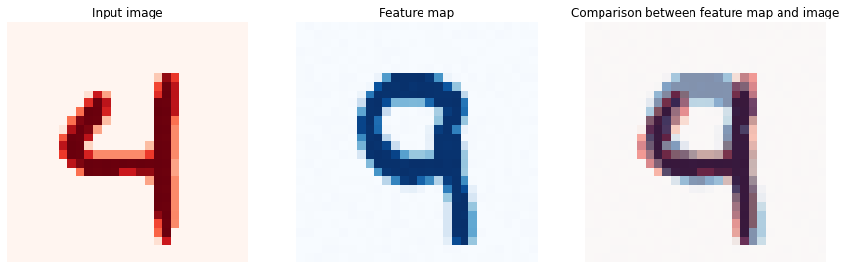
Low Test-Accuracy Explanation
Low test-accuracy explanation

Slide 18
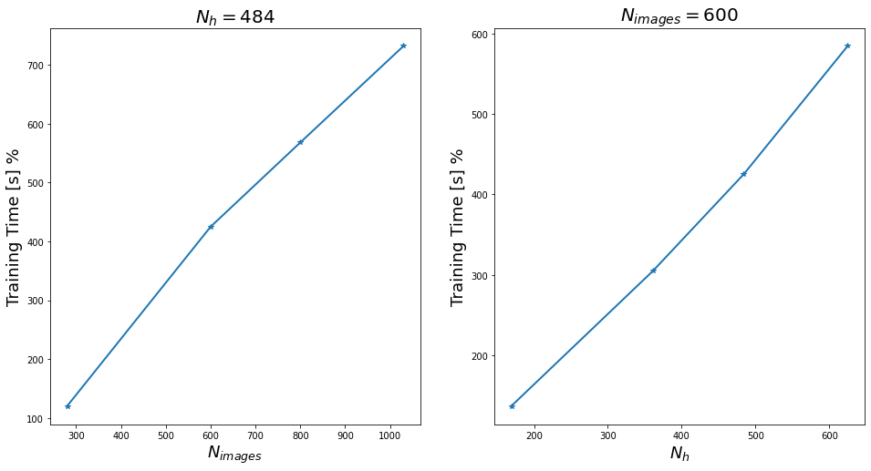
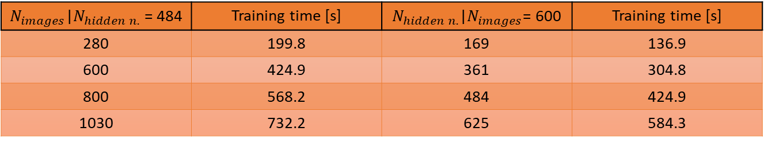
Training Time
Training Time
$N_{images}$|$N_{hidden n.}$ = 484 | Training time [s] | $N_{hidden n.}$|$N_{images}$= 600 | Training time [s]
280 | 199.8 | 169 | 136.9
600 | 424.9 | 361 | 304.8
800 | 568.2 | 484 | 424.9
1030 | 732.2 | 625 | 584.3

Slide 19
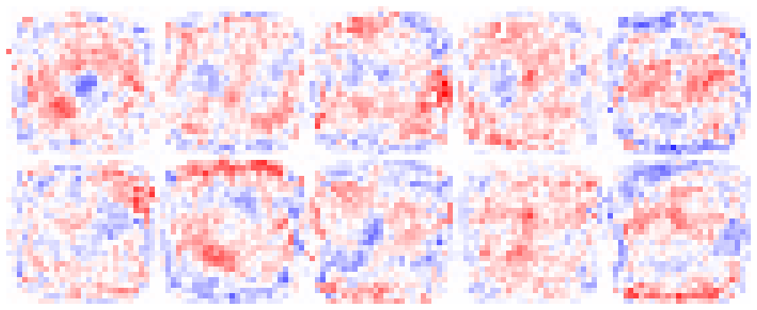
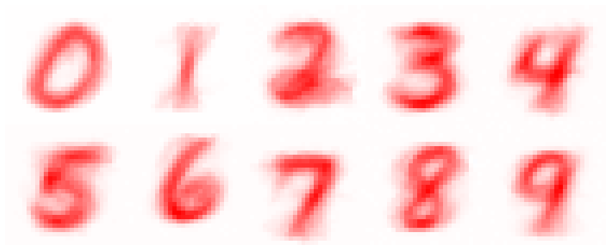


Feature Maps Comparison
Fig. Comparison between feature maps of the second layer.
Fig. Comparison between some feature maps of the first layer.

Slide 20



Interpretation Second Layer
Input Image
Feature maps of the top-hidden neurons

Slide 21




Biological ODE
Biological ODE
Within-layer competition
between neurons
ReLU activation function
$$τ_{r}\frac{dh_{μ}}{dt}=I_{μ}−w_{inh}\sum_{ν≠μ}{r\left(h_{ν}\right)}−h_{μ}$$
$$τ_{h}\frac{dh_{μ}}{dt}={Ψ(I}_{μ})−h_{μ}$$
Characteristic time scale of the input dynamic
v-equation of the firing rate model
v-equation of the firing rate model
Activation function determining
the learning paradigm
No-learning
Anti-Hebbian Regime
$$τ_{w}\frac{dw_{μi}}{dt}=g(h_{μ}) \left[v_{i}−\left(\sum_{k=1}^{784}{w_{μk}}v_{k}\right)w_{μi}\right]$$
$$g\left(h\right)=\left\{\begin{aligned}0 if h<0 \\ −∆ if 0<h<h^{∗} \\ 1 if h^{∗}<h\end{aligned}\right.$$
Hebbian Regime
Characteristic time scale of the weights dynamic
Normalization Constraint

